Slide 1
Paving 2024

Slide 2
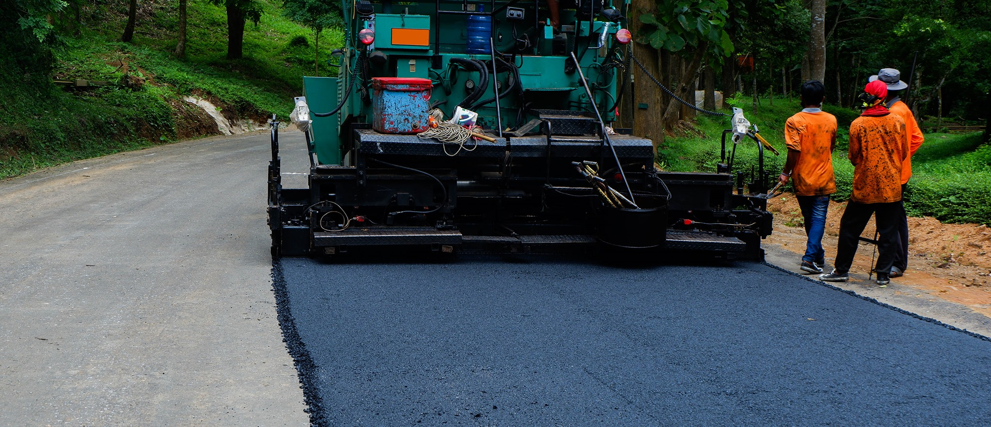
The 3 Processes we will be using for road resurfacing
Over Lay-An overlay, as its name implies, is simply a new pavement section(generally 1.5”-2.”thick) placed over the top of an existing pavement surface

Slide 3
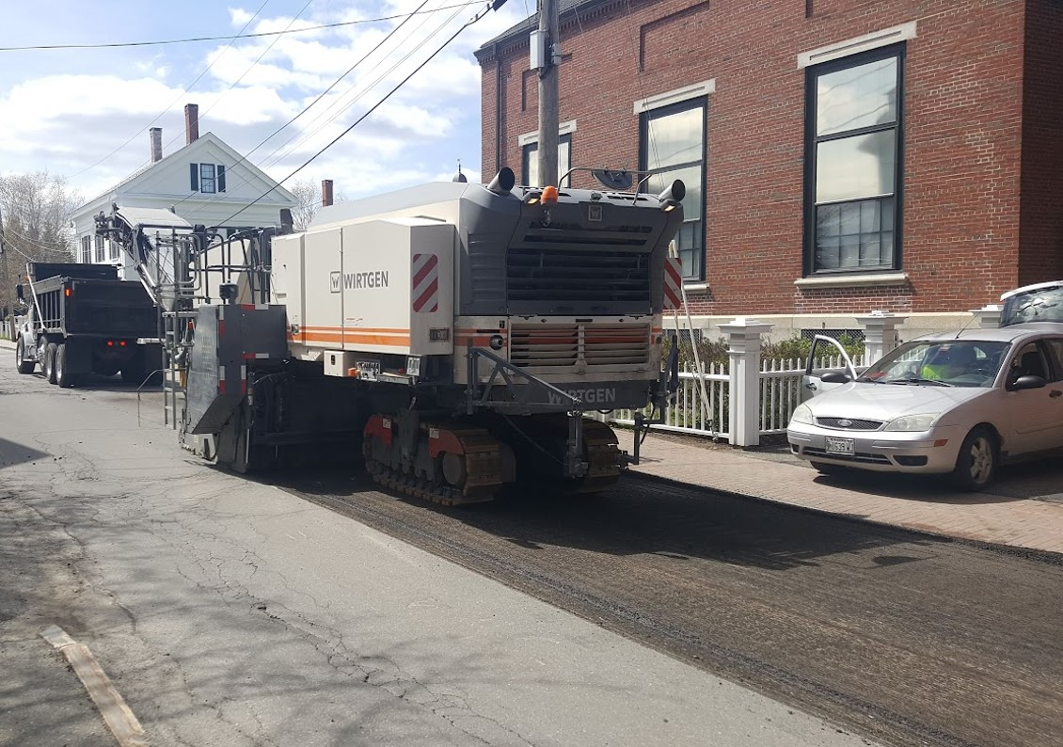
Mill & Fill – Would be grinding and removing roughly 2” and then placing 2.5-3”
back

Slide 4
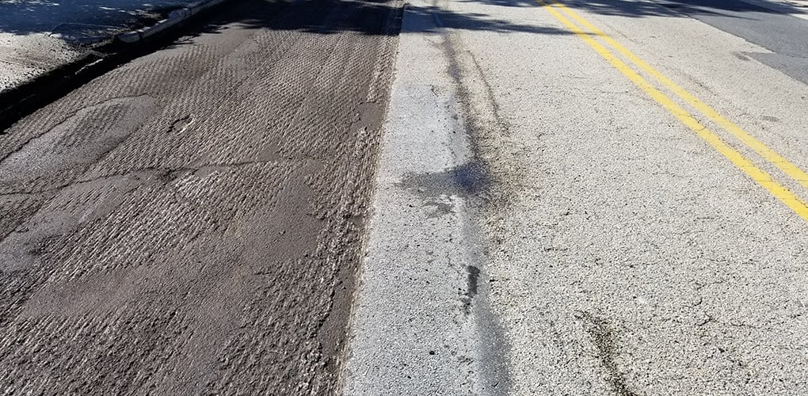

Slide 5
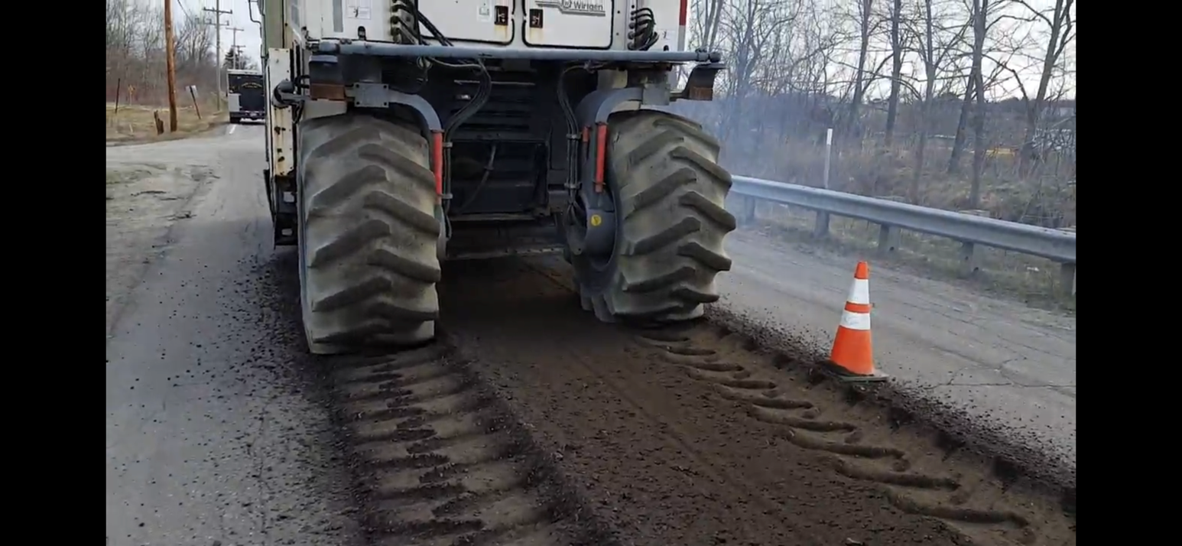
FDR (Full Depth Reclamation) – is an in-place recycling method for reconstruction of existing flexible pavements using the existing pavement section material as the base for the new roadway-wearing surface.

Slide 6
Roads & Treatment for 2024
Rankin St. – Overlay exiting pavement that was done in 2022, Replace and overlay sections of the sidewalk
Mountain Rd.- Overlay exiting pavement that was done in 2022.
Broad St.- Mill & Fill, Limerock St. to Park St.
Lincoln St.- Mill & Fill, Limerock St. to Talbot Ave.
Maple St.- Mill & Fill, Lincoln St. to White St.
Beech St.- Mill & Fill, Broadway to Union St.
Grove St.- Mill & Fill, Lincoln St. to Union St.
Willow St.- Mill & Fill, Broadway to Union St.
Hill St.- Mill & Fill, Broadway to Fogg St.
Fogg St.- Mill & Fill, Willow St. to Rankin St.

Slide 7
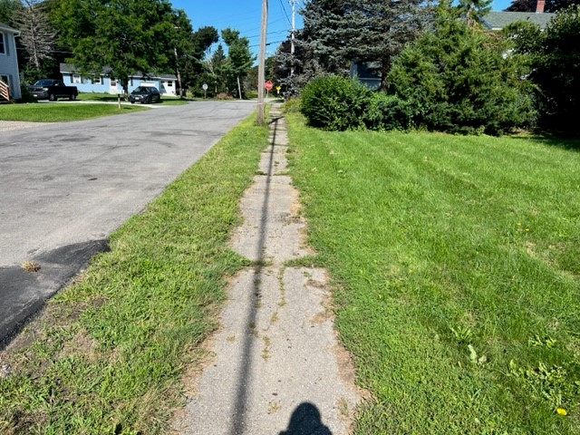
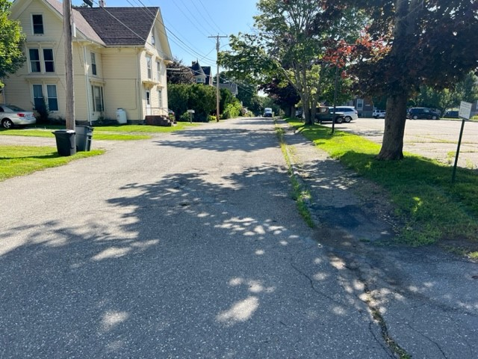
Sidewalks 2024
Gay St.- Will replace from North Main to Broadway
Gay St. – Add new from Broadway to McDougal Park
Limerock St. – Replace From Broadway to Broad St.
Maple St.- Replace from Lincoln St. to Maple St.
Grove St.- Replace from Lincoln St. to Union St.
Franklin St.- Replace from Holmes St. to Pleasant St.
Lincoln St.- Replace from Limerock St. to Talbot Ave.
Purchase St. – Replace from Holmes St. to Pleasant St.
Beech St.- Replace White St. to Broadway
Willow Street- Replace from Main St to Broadway

Slide 8
Rockland, Maine
COMPREHENSIVE PLAN ^{• FEBRUARY 2022}
IMPLEMENTATION AND EVALUATION
The Comprehensive Plan outlines a vision for Rockland’s future along with establishing a set of goals and objectives for
topics ranging from housing to natural resource protection. To help achieve these, the plan also identifies an ambitious list of
recommended strategies and actions, ranging from the broad to the specific. Successful implementation of these strategies
in the long term will require continued review of roles and responsibilities, prioritization of timelines, sufficient budgets,
consideration of staff time and capacity, synergies with other projects and opportunities, and regular review of progress.

Slide 9
Page 7
Mobility
Create a network of safe, connected and accessible streets, paths, and trails.
Pursue opportunities to improve walkability, connectivity, and accessibility such as:
Implement Complete Streets wherever feasible
Maximize sidewalk width where appropriate
Add and connect sidewalks wherever feasible
Identify and add crosswalks where needed
Implement traffic calming measures where needed
Develop and enhance local and regional trail system (e.g. walking, biking, hiking);
Incent easements for sidewalks, trails and views through code provisions and Tax Increment Financing.
Develop a 5 to 10-year road repair and maintenance strategy.

Slide 10
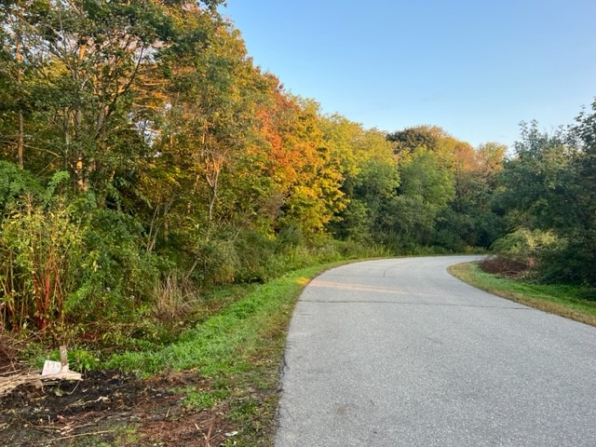
Proposed New Sidewalks
Lawn Ave.- Continue from the end to Cedar St.

Slide 11
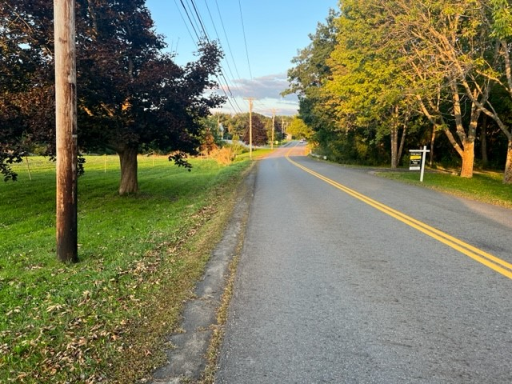
Waldo Ave.
From Littlefield Memorial Baptist Church to Samoset Rd.

Slide 12
Mechanic St. – From South Main St. to Snow St.

